Slide 1
Math3910 Midterm
Modeling Report
Project No. 7
Model Comparison Based on the Dataset of the Growth Rates of Unemployment in the USA
Shiyu (Jason) Jiang
1098451
April 27, 2021

Slide 2
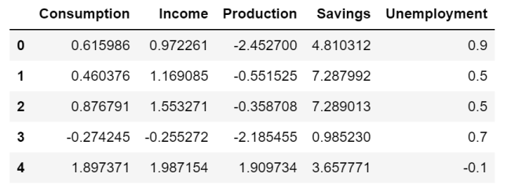
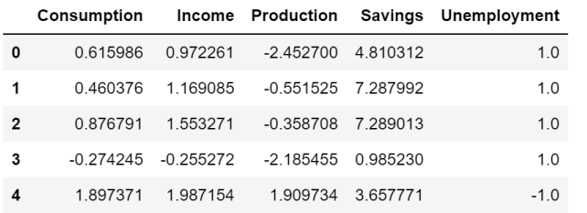
Data Check

Slide 3
Long Short-Term Memory

Slide 4
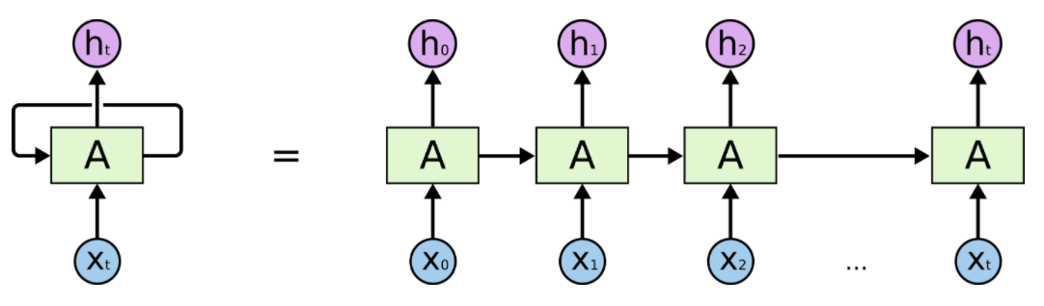
Recurrent Neural Network
Historical information will be preserved and pass to the next cell.

Slide 5
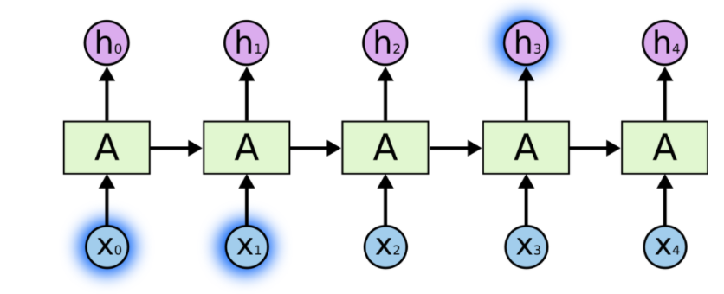
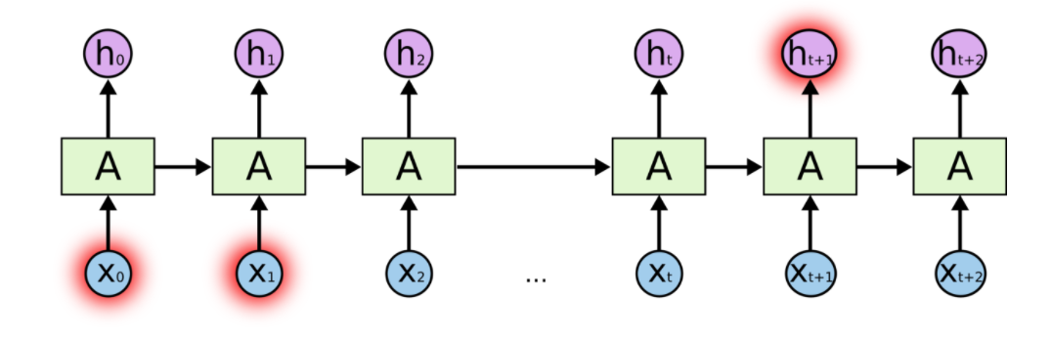
Limitation
Cannot effectively use historical information when the distance increases.

Slide 6
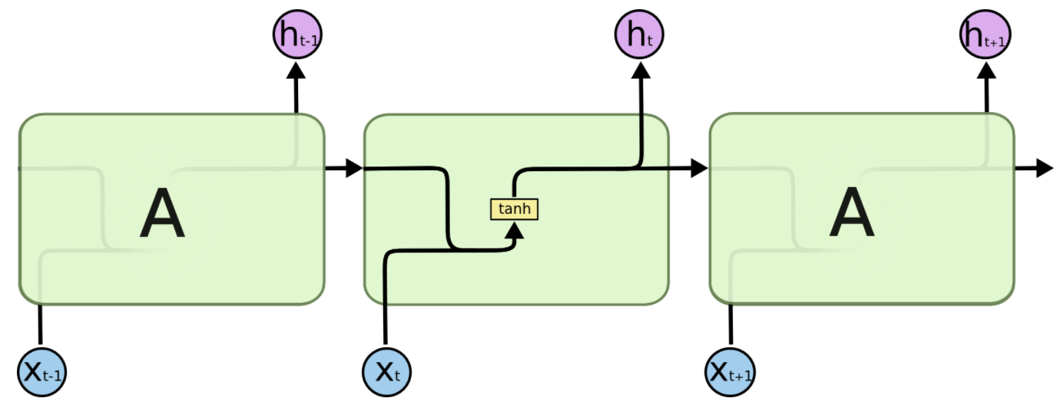
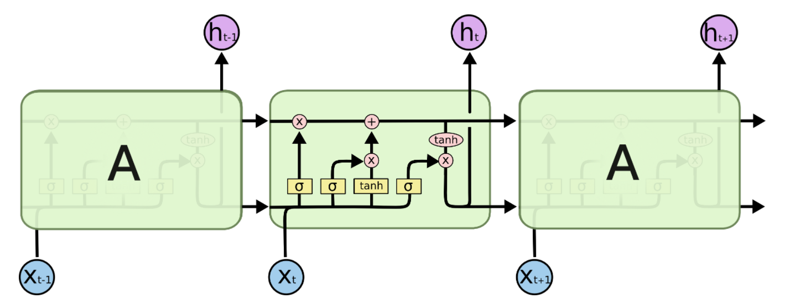
LSTM – A Special RNN
Selective Forgetting
Selectively choose the information from previously passed information, dump unimportant, get important. Not simply superimposing information like what naïve RNN does.

Slide 7
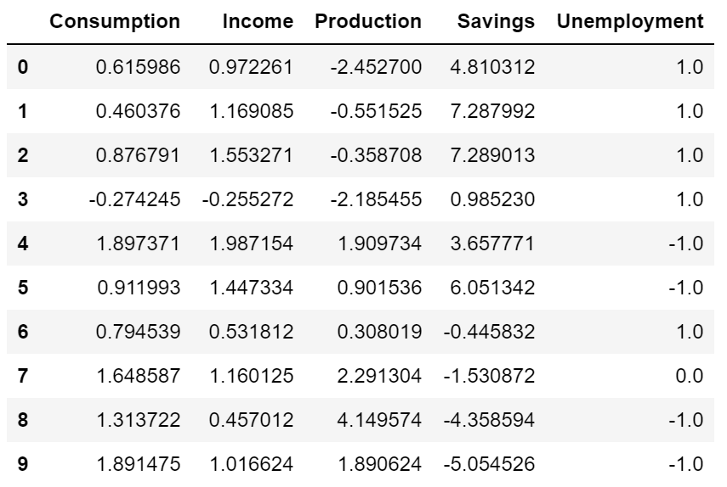
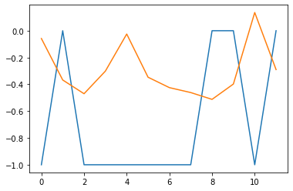
Prediction with LSTM
The prediction is not perform very well, since it is the growth ratio, which contain not much historical information. The solution is to convert it into real value, which can show the trend of increase and decrease.

Slide 8
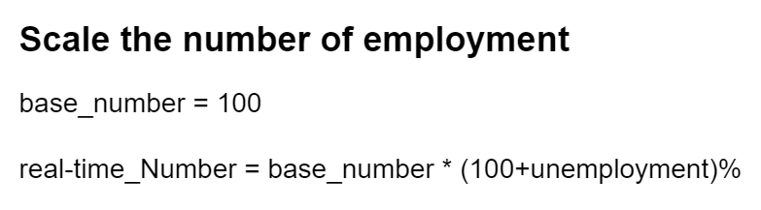
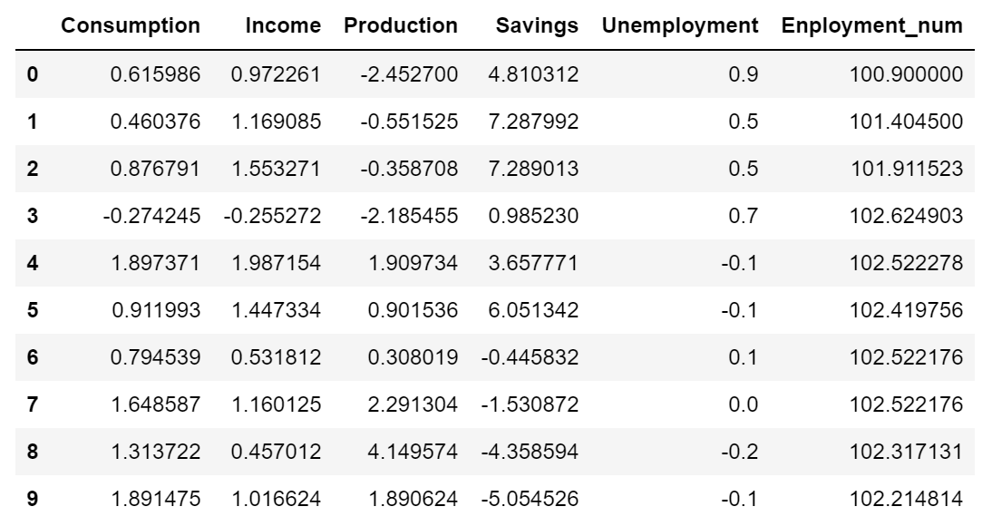
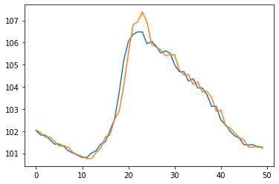
Prediction with LSTM -- Improvement

Slide 9
Grey Model

Slide 10
Definition
Grey prediction model is based on the theory that the data is complex but regular overall.
GM (1, 1) Model
One of the frequently used model is GM ( 1,1) Model which is based on weighting accumulated generating operation.
Other ways of Generation
1. Accumulate Subtract Generation
2. Accumulate Plus Generation
3. Mean Generation
4. Scale Generation

Slide 11
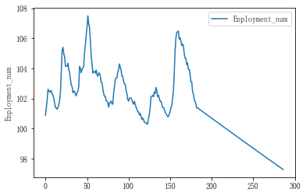
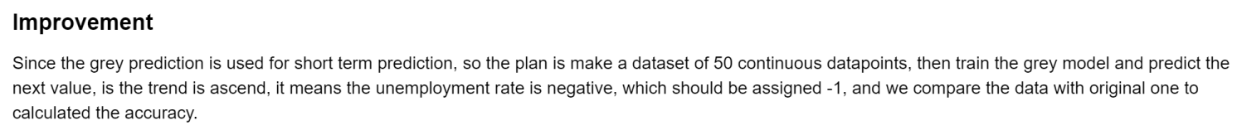
Strategy Analysis

Slide 12
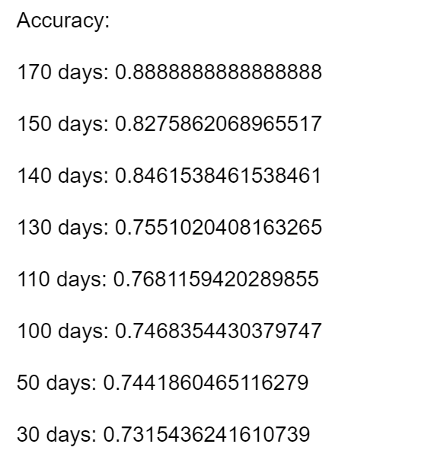
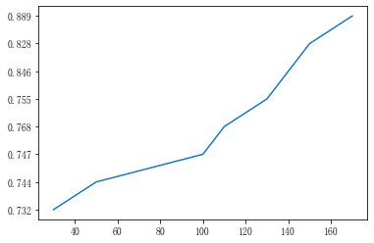
Result Presenting
The performance is stable and steady. We can see the time-series model can do well in the prediction.

Slide 13
Machine Learning

Slide 14
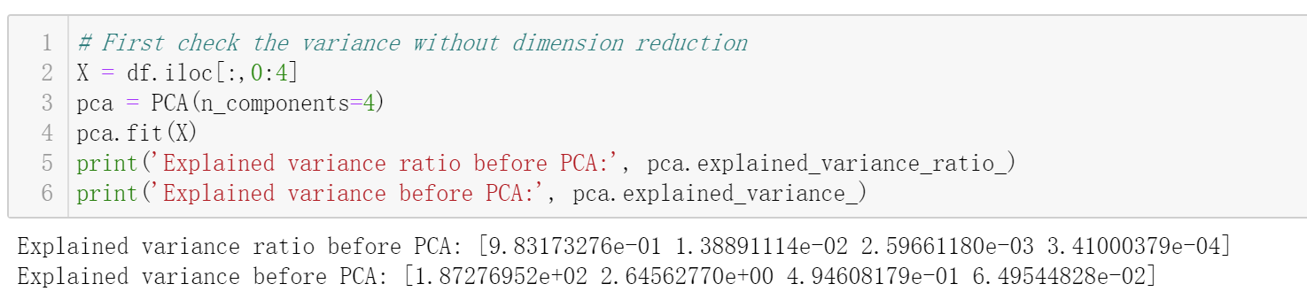
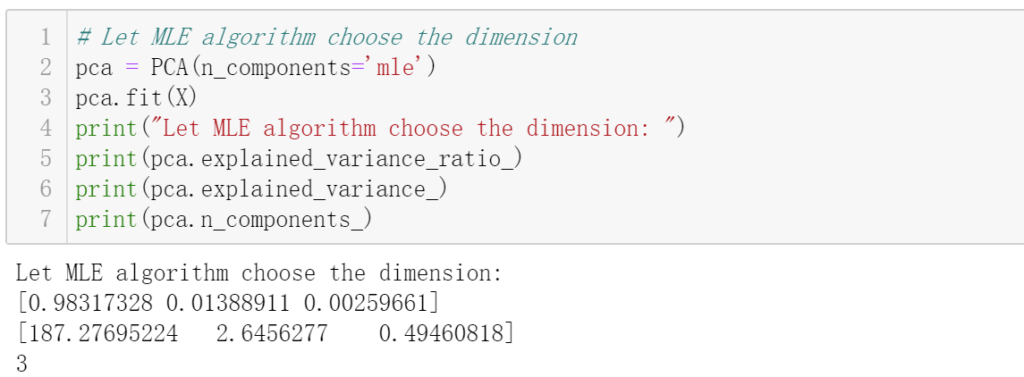
Data Preprocessing -- PCA

Slide 15
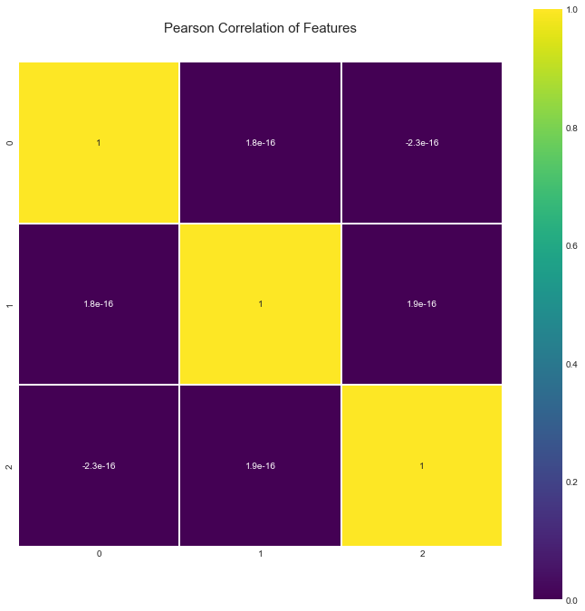
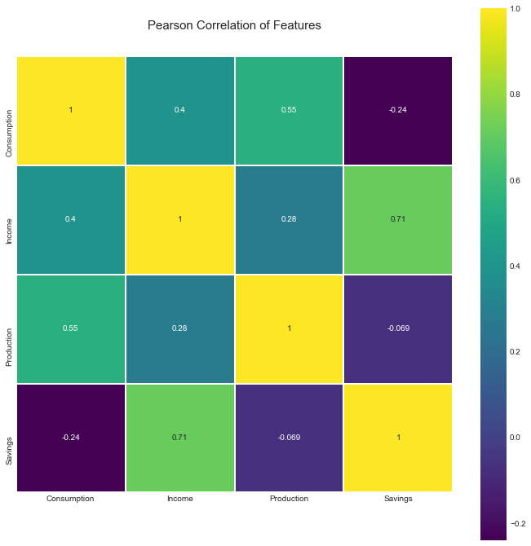
Data Preprocessing -- PCA

Slide 16
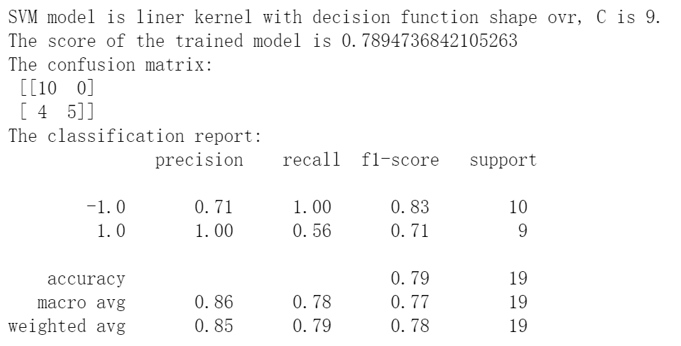
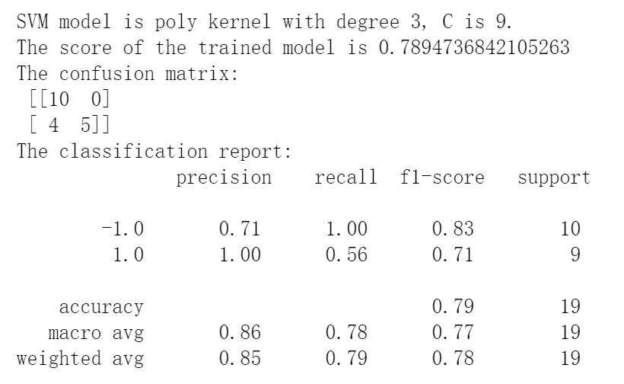
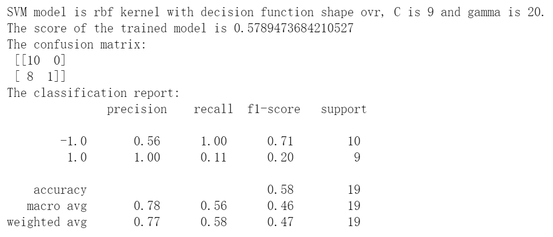
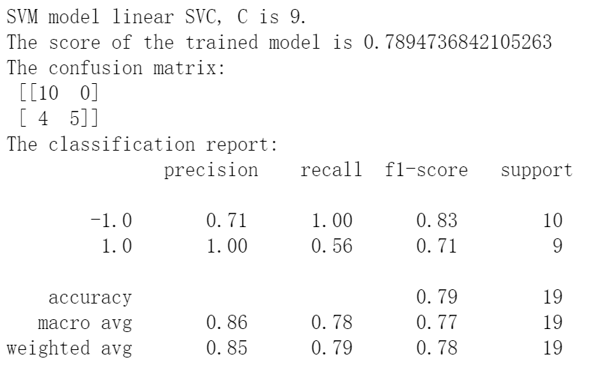
Modeling -- SVM
Original Data

Slide 17
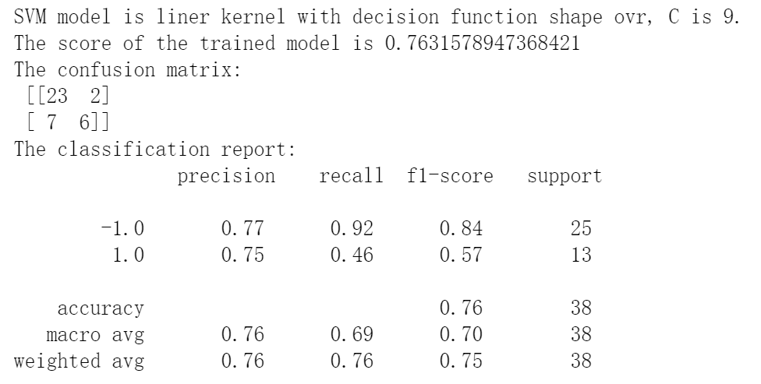
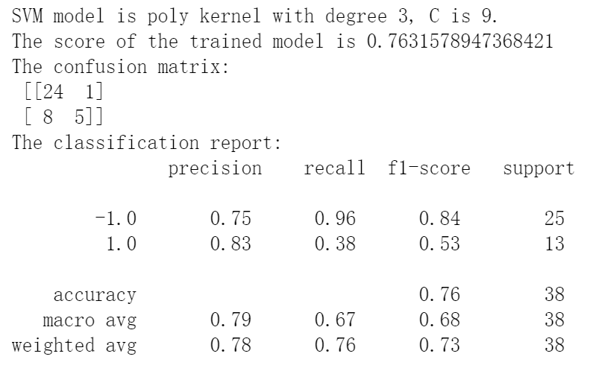
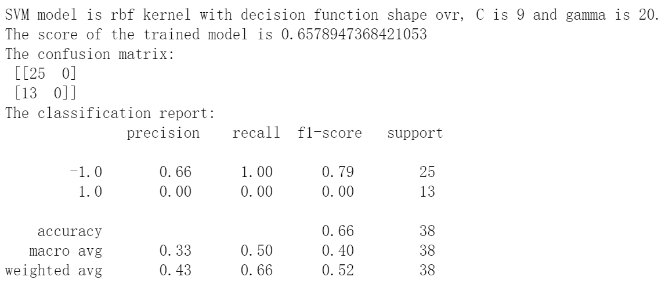
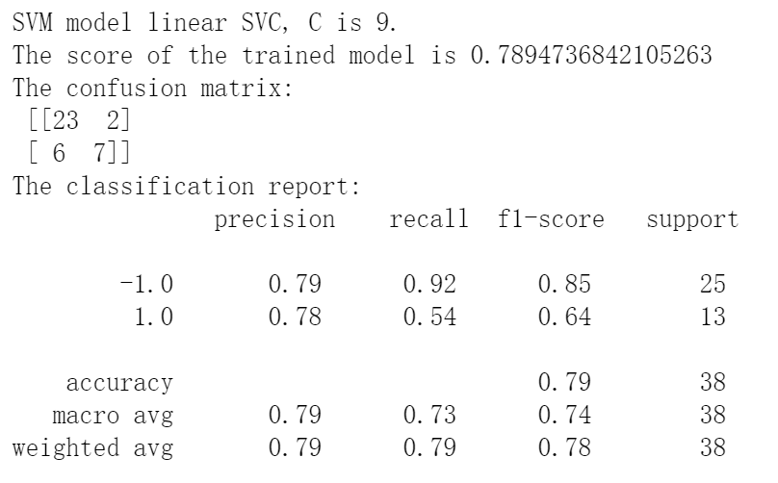
Modeling -- SVM
Reduced Data

Slide 18
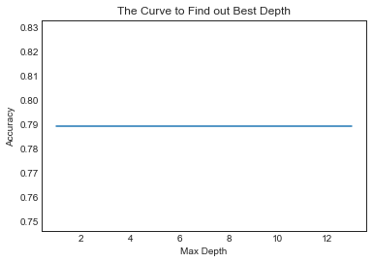
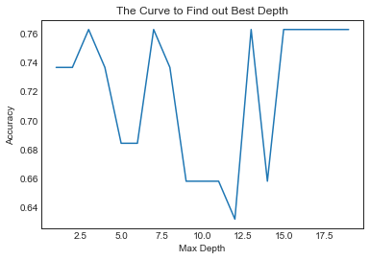
Modeling – Decision Tree
Original Data
Reduced Data

Slide 19
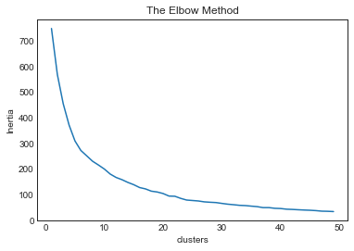
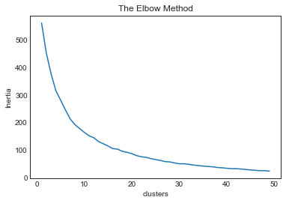
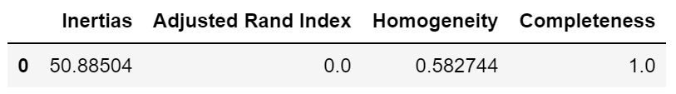
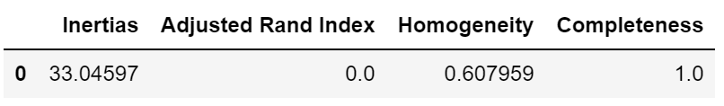
Modeling – K-Means Clustering
Original Data
Reduced Data

Slide 20
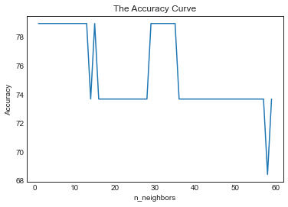
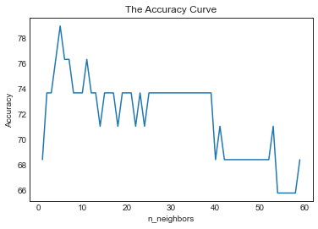
Modeling -- KNN
Original Data
Reduced Data

Slide 21
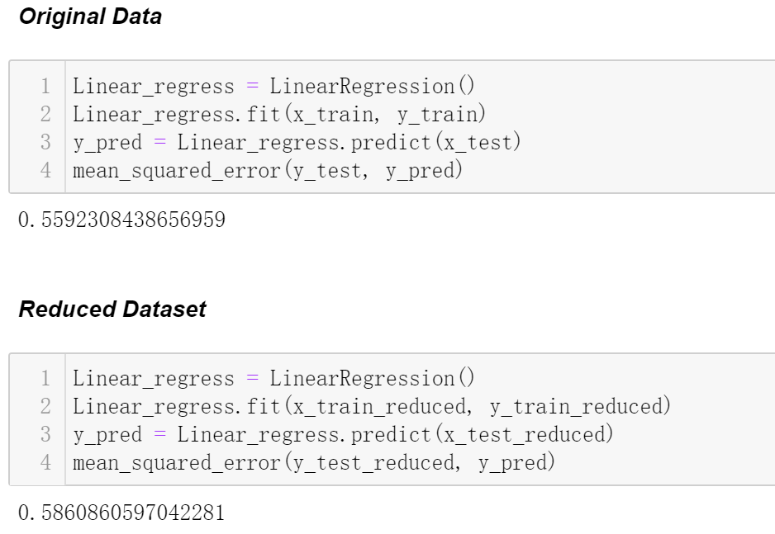
Modeling – Multiple Linear Regression
Original Data
Reduced Data

Slide 22
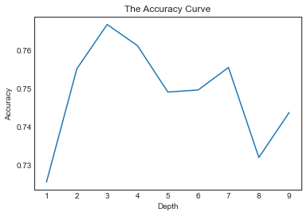
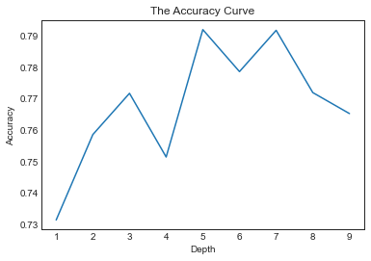
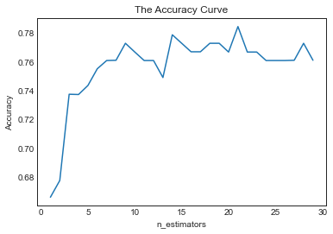
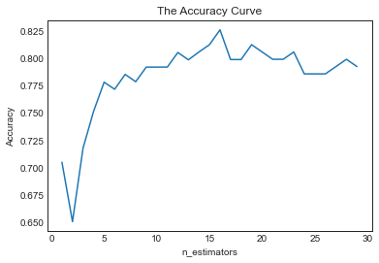
Modeling – Random Forest
Original Data
Reduced Data

Slide 23
Model Comparison

Slide 24
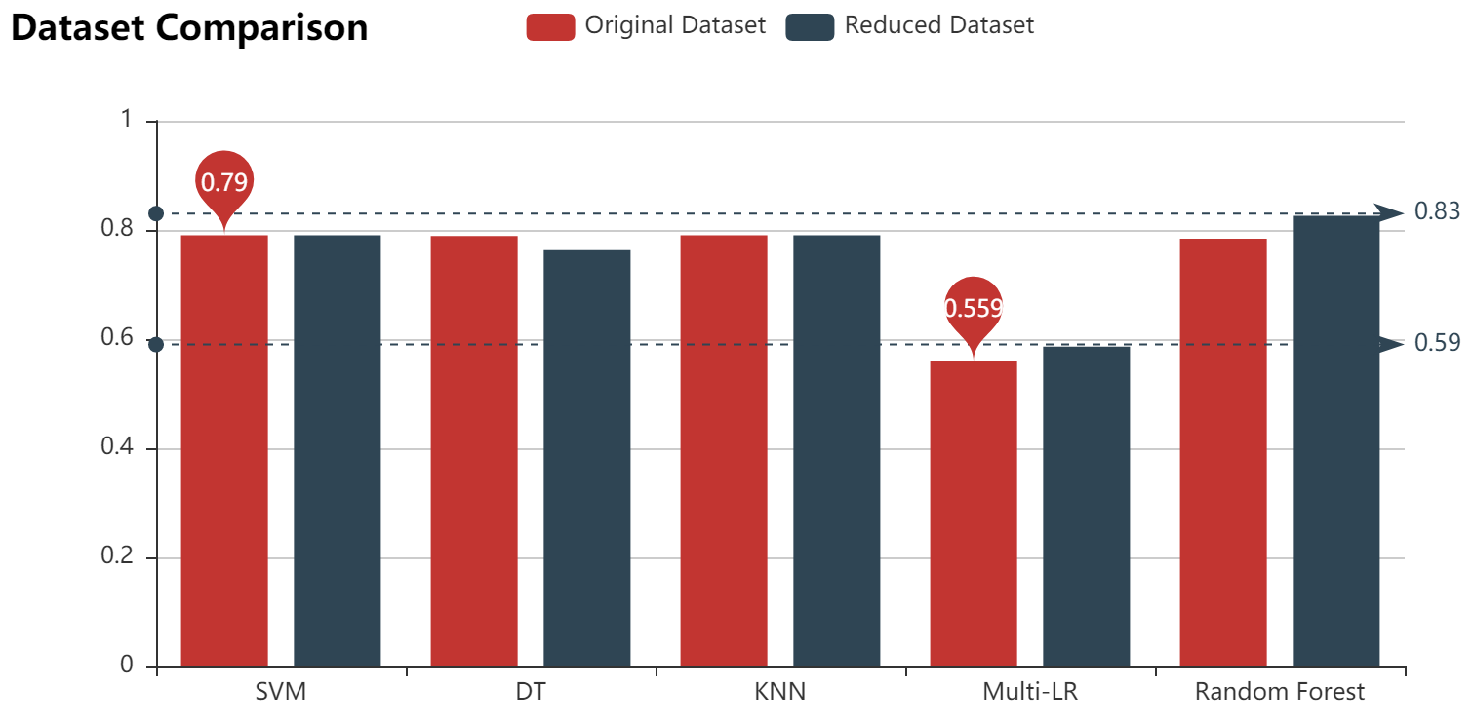
K-Means

Slide 25
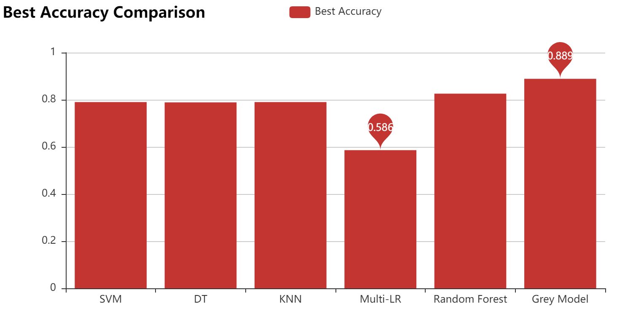

Slide 26
Thank You!

